Slide 1
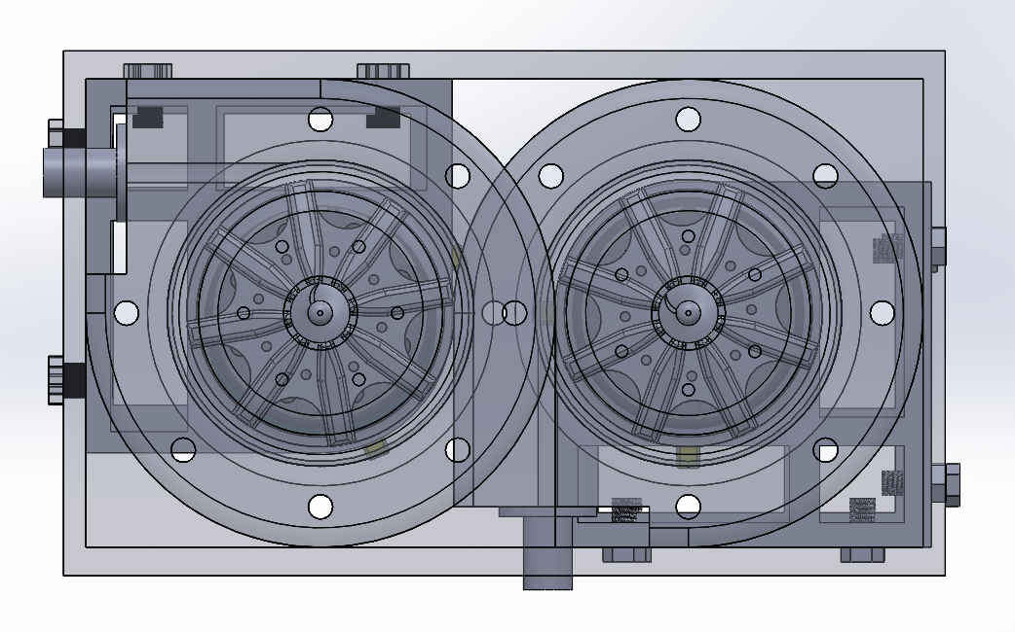
Flight Ready Electric Feed System
Project No: 13
Faculty Advisor: TBD
Sponsored by: PSAS, PSU, NASA OSGC

Slide 2
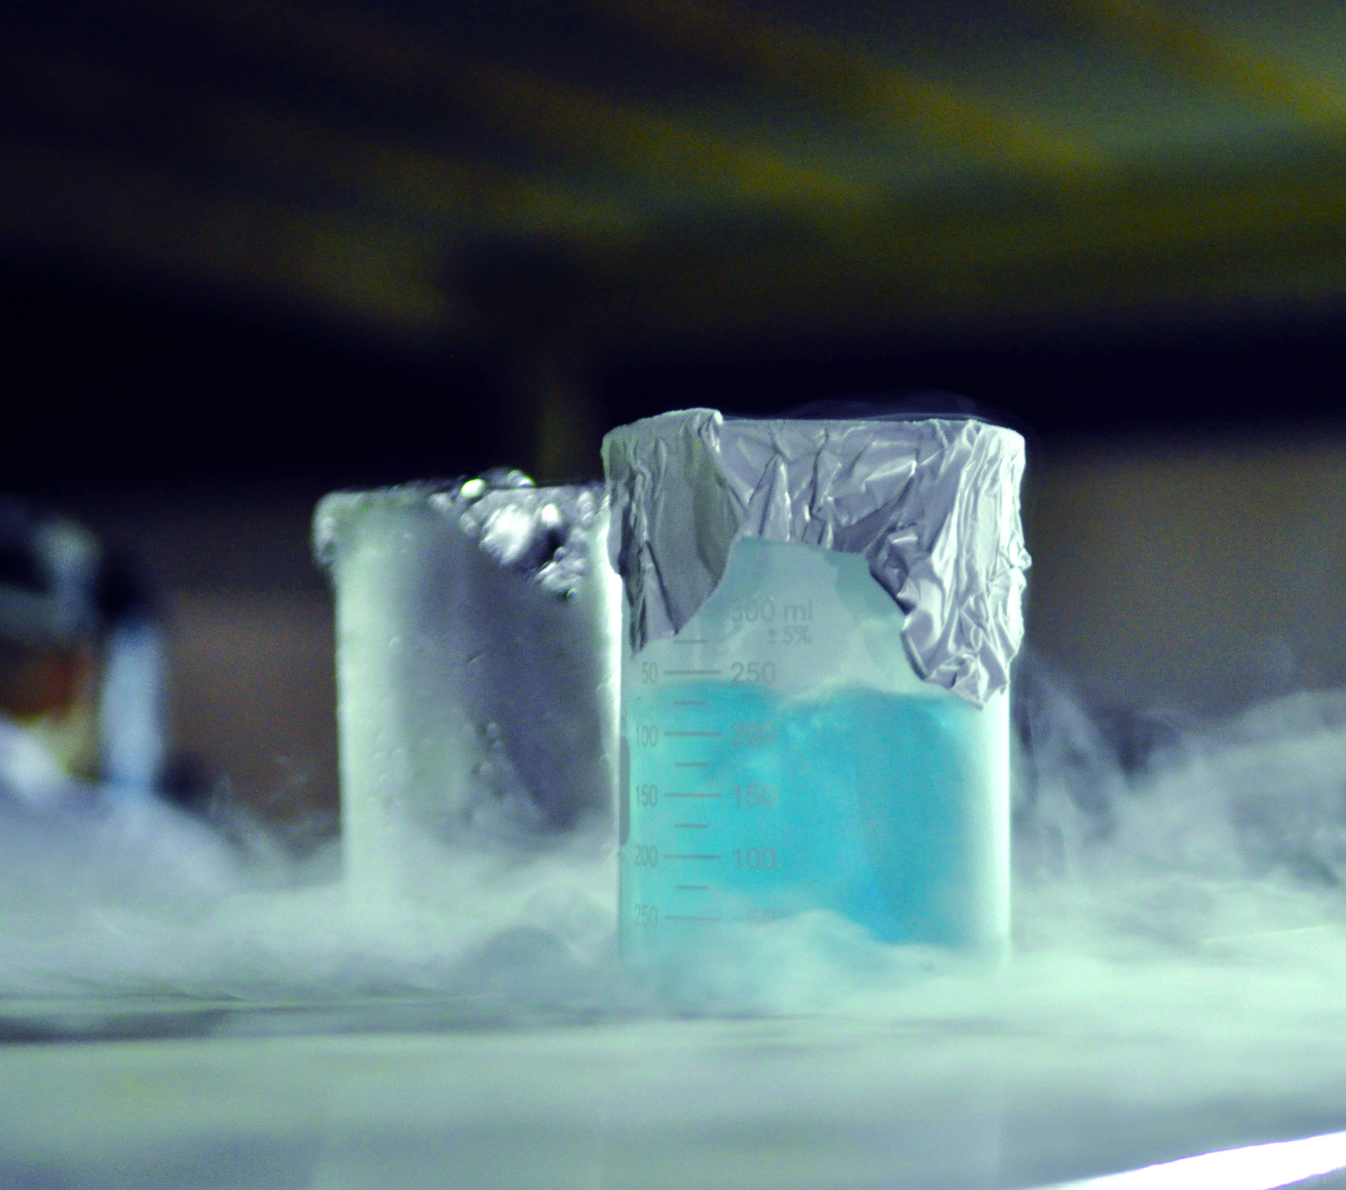
Customer Requirements
PSAS Electric Feed System
Compatibility Requirements
Liquid Oxygen (LOX)
Isopropyl Alcohol
Propellant Safety
Embedded Sensors
Chemical Safety Training for LOX

Slide 3
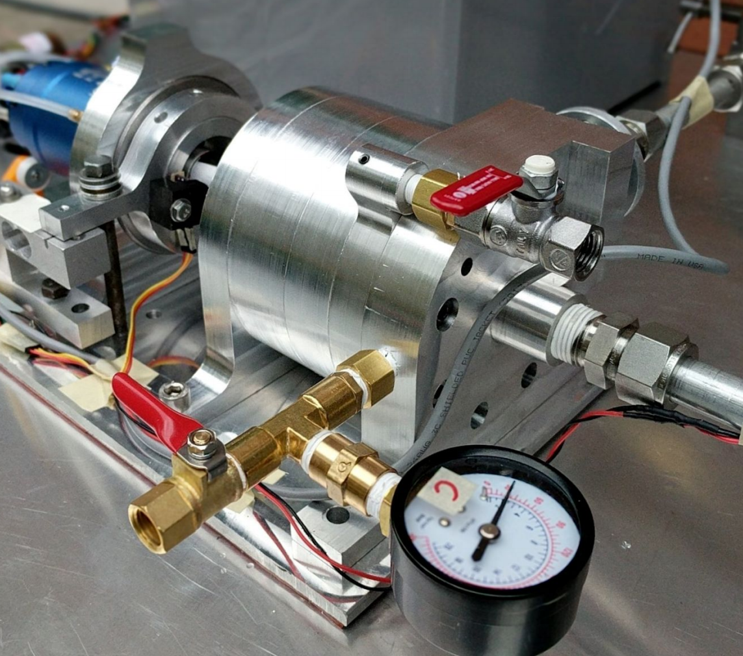
Engineering Requirements
Requirements | Units | Values
P | [psi] | 400
ṁ | [kg/s] | 2.07
Motor Power | [kW] | 5-6
Rotation Speed | [rpm] | 12k-22k
Thrust | [kN] | 2.2
Acceleration | [g] | 10
Airframe Diameter | [in] | 12
PSAS Electric Feed System

Slide 4
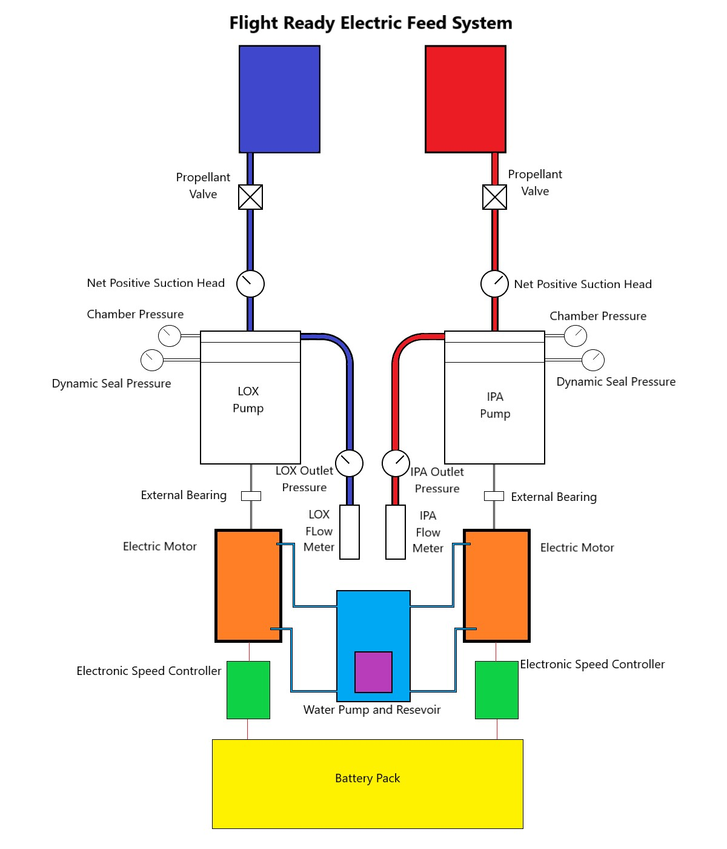
Electric Feed System Overview

Slide 5
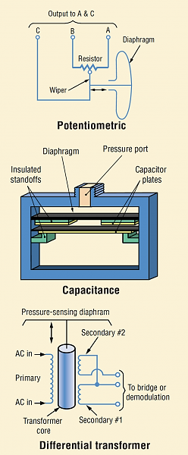
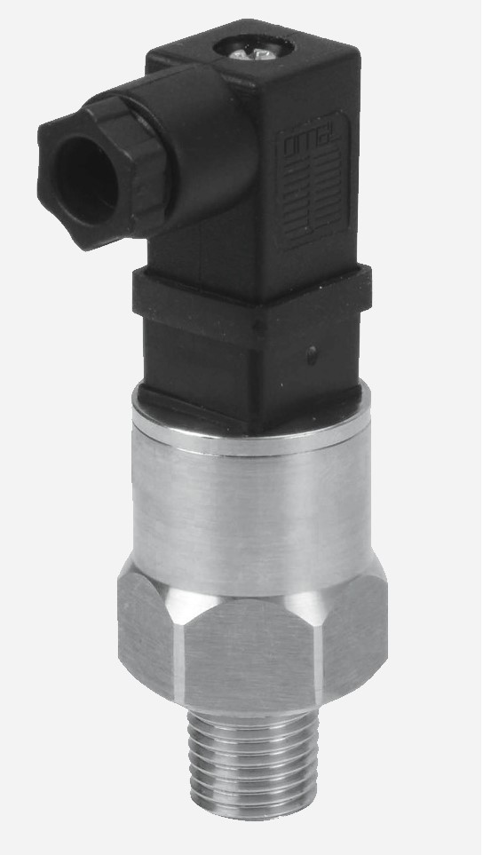
Pressure Data
Specifications
0 – 500 PSI
Under $200
Challenges
Cryogenic Capability
Lox Compatibility
Specifications
0 – 500 PSI
Under $200
Design Challenges
Cryogenic Capability
LOX Compatibility

Slide 6
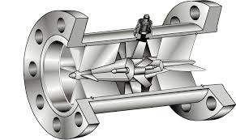
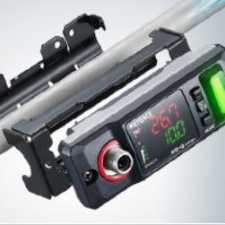
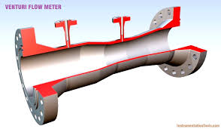
Flow Data
Meter Options
Turbine
Ultra Sonic
Venturi

Slide 7
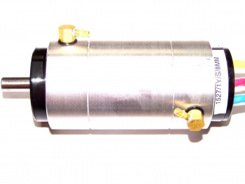
Electric Motor Selection
Torque Output
RPM Capability
Water Cooling
Speed Controller

Slide 8
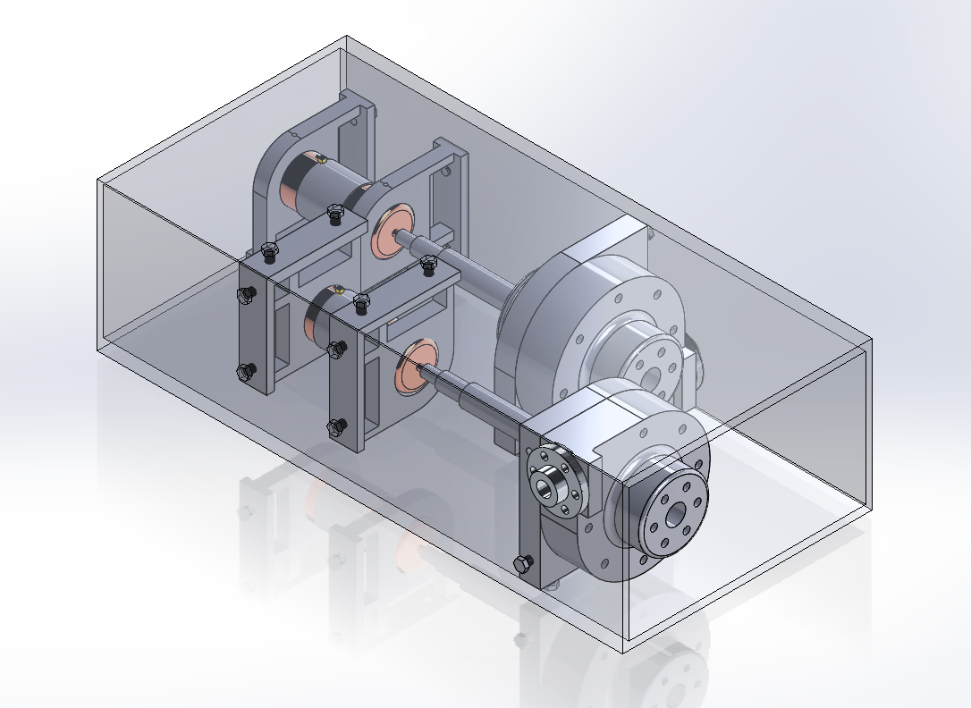
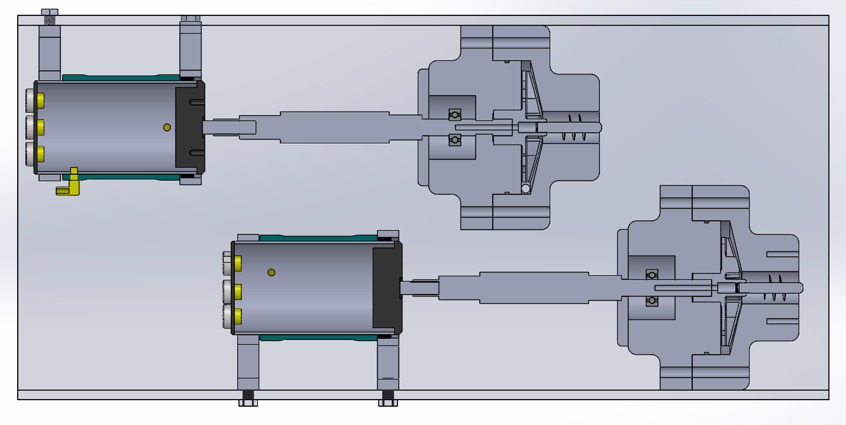
Full System Design Concept
Twin Pump Decision
Material Selection
Airframe Mounts
Electric Motors

Slide 9
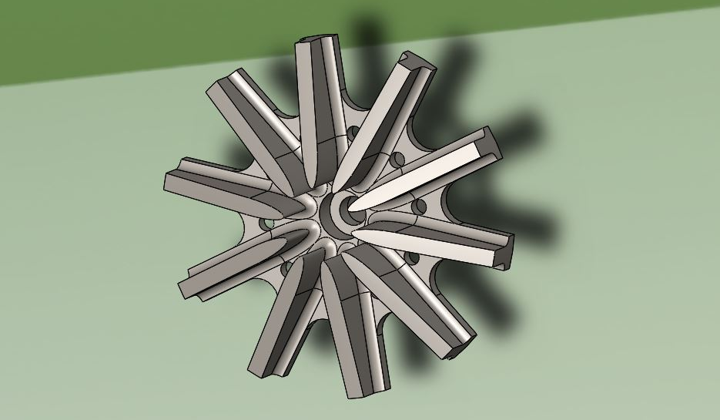
Impeller Design
Blade Count
Inducer
Shaft Mating
Material
Manufacturing

Slide 10
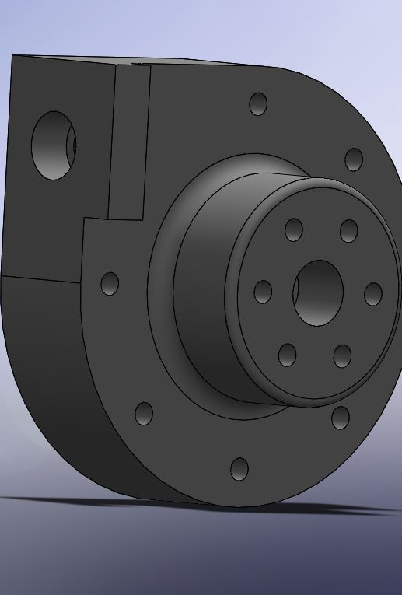
Current Manufacturing
Purchasing Tool/Cutters
Plastic Test Trials

Slide 11
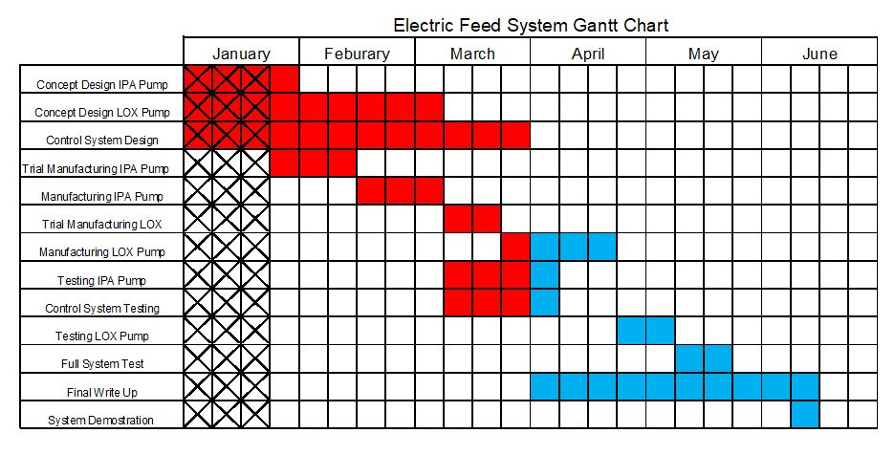

Slide 12

Stay Tuned!

